Slide 1

The merits of using compost dressing & the benefits to soil health
Ben Dyson FQA
Technical Advisor
Field Compost Ltd

Slide 2

Contents
Growing and caring for grass
Understanding soil and soil function
The importance of soil organic matter
Sources of soil organic matter
What is compost
BSI PAS100 (2018)
Making lawn dressing fit for purpose
Characteristics, benefits and use
Summary

Slide 3
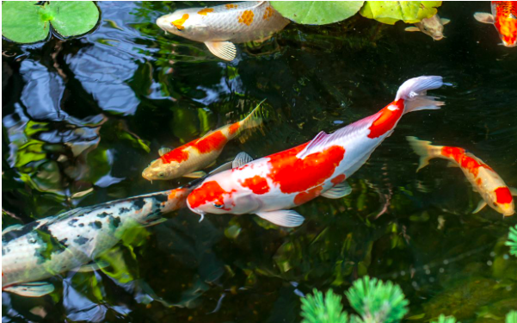
“It’s Not Keeping Fish, It’s Keeping Water”
My Dad
Q: What breed of koi carp is in the centre of the photo?
A: Kohaku

Slide 4
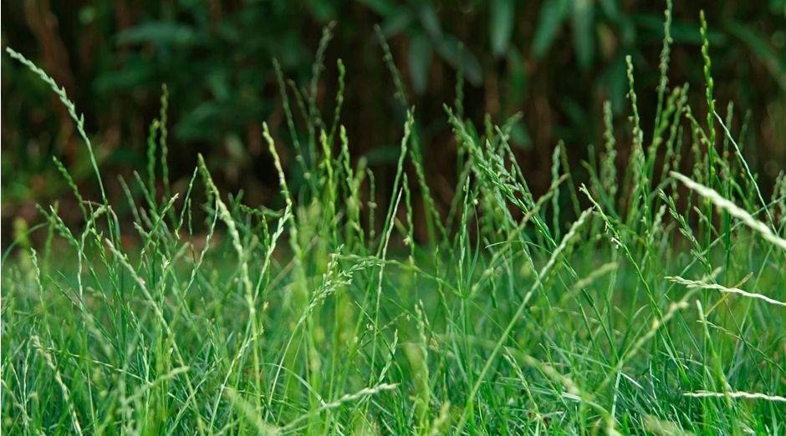
Grass Varieties found in UK Lawns are all cultivars of Native grass species
Q. What species of grass is in the photo?
A: Perrennial Rye Grass
(Lolium perenne)

Slide 5
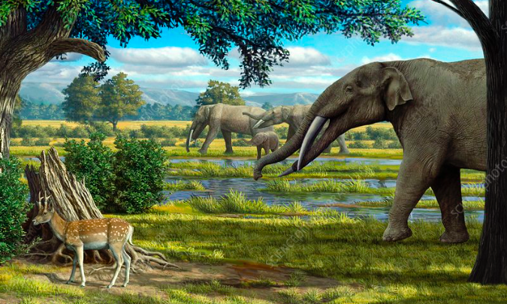
Native Grass Species have evolved over millions of years to be reliant upon healthy Functioning soils
Q. When did the first grass species appear on earth?
A. 66 Million years ago

Slide 6
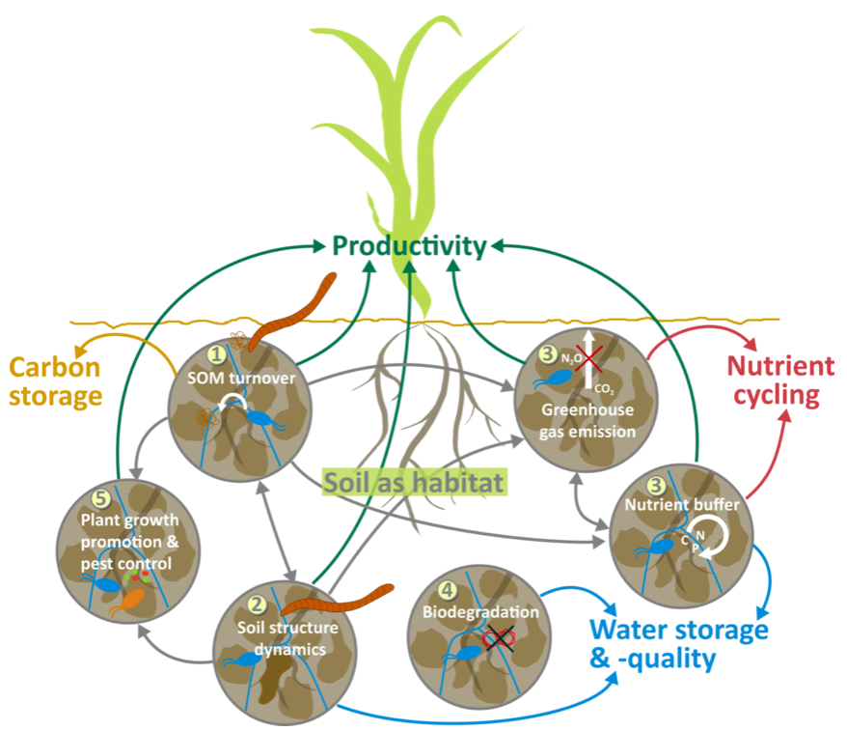
Understanding Soil and Soil Function
medium for plant growth
regulator of water supplies
recycler of raw materials
habitat for soil organisms
landscaping and engineering medium

Slide 7
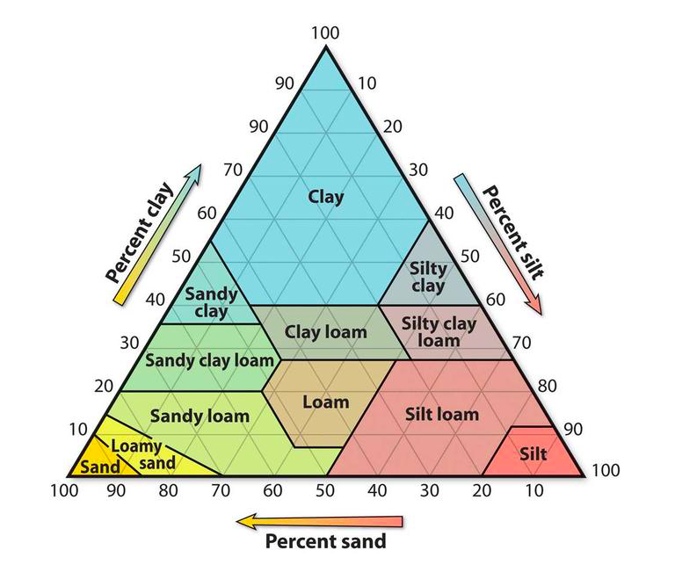
Soil types – are defined by texture….
Q. Which soil texture has the smallest particle size?
A. Clay

Slide 8
…but there’s much more going on than that
Sand
Clay
Biomass
Air
Silt
Organic matter
Water

Slide 9
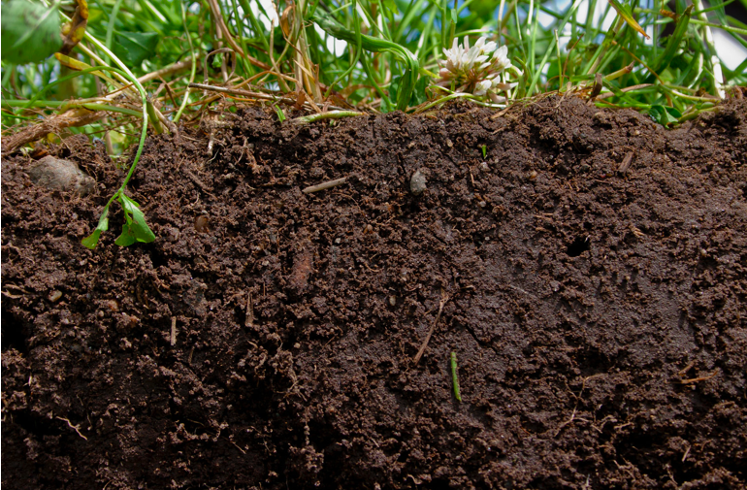
The Importance of Soil Organic matter (SOM)
Q. What is soil organic matter (SOM)?
A. Soil organic matter is any material produced originally by living organisms (plant or animal) that is returned to the soil and goes through the decomposition process

Slide 10
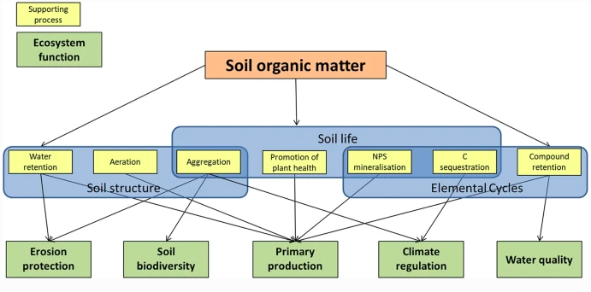
The Importance of Soil Organic matter (SOM)

Slide 11
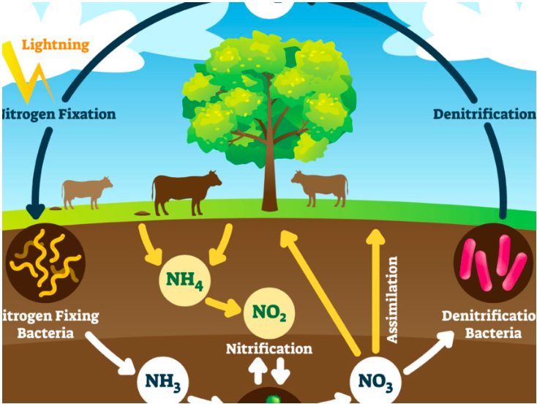
Organic Matter = Soil Life
Soil Life = Soil Nutrient Function
Most soil microorganisms use organic compounds in soil organic matter as carbon and energy sources. These microorganisms are essential for nutrient cycles to function.

Slide 12
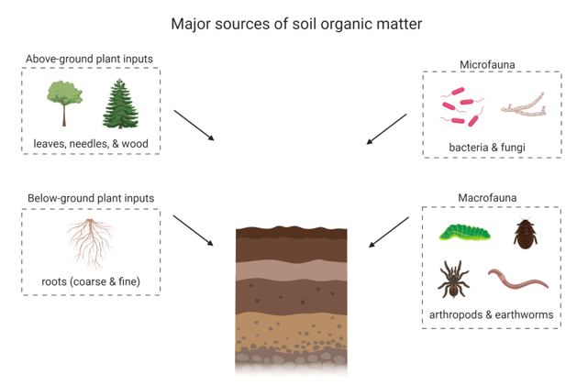
Sources of Soil Organic matter
We can also introduce organic amendments such as manure, peat or compost…

Slide 13
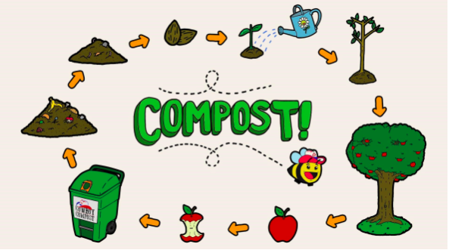
What is Compost?
To make compost there are four essential ingredients…
Carbon (25 parts)
Nitrogen (1 part)
Oxygen (>5%)
Water (40 – 60%)

Slide 14
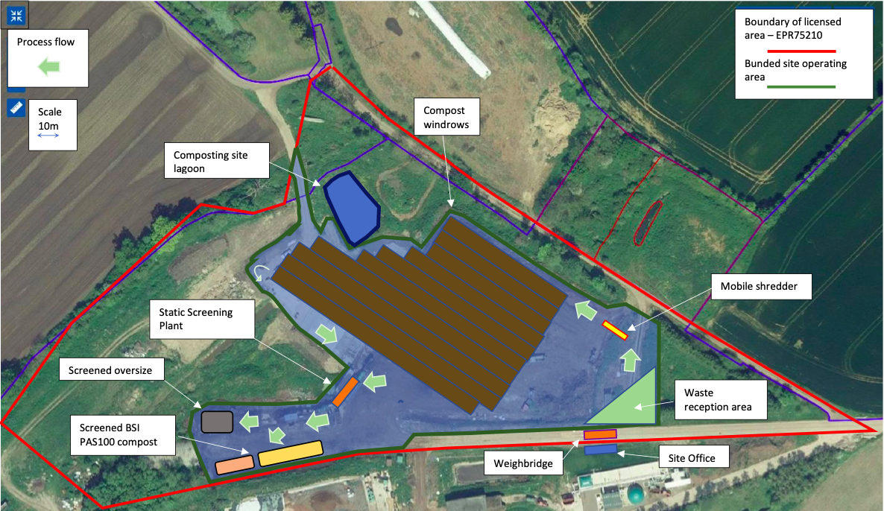

BSI PAS100 (2018)

Slide 15
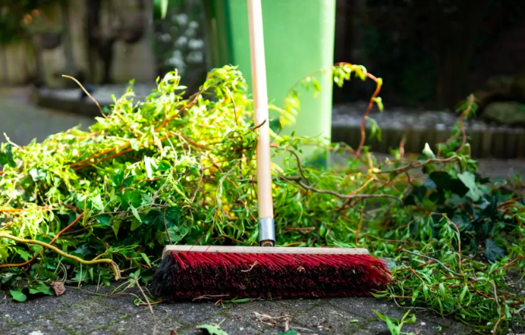
Source Segregated Garden Materials

Slide 16
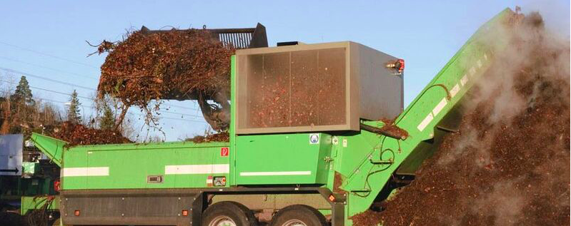
Shredding

Slide 17
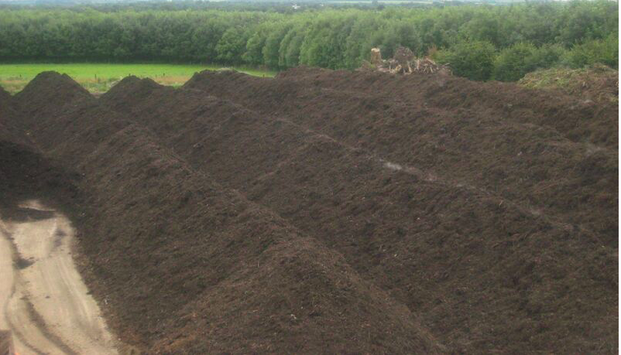
Open Windrow Composting

Slide 18
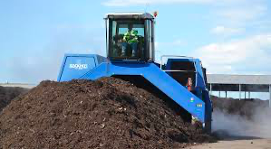
Turning

Slide 19
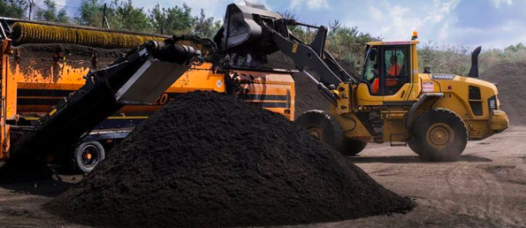
Screening

Slide 20
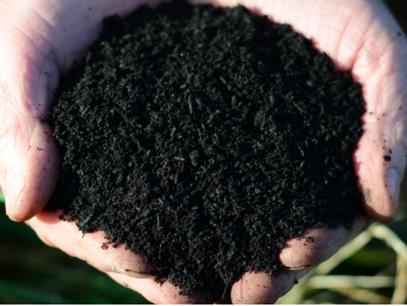
Making it fit For Purpose and Going the Extra Mile
Direct management of PAS100 QMS
Compost sufficiently matured
Patented screening equipment to ensure uniform particle size
Moisture content controlled for ease of spreading

Slide 21
Typical Characteristics and Benefits
Compost Grade | 0-4mm
Batch Age when sampled | 16 Weeks
Analytical Results |  |  | Benefit Summary
DM basis unless otherwise stated | Units | Result | Amount per tonne (fresh weight) | Converted Units
Bulk density | grams/L | 500
pH |  | 8.1
Organic Matter | % | 44.8 | 211.90 | Kg
Dry Matter | % | 47.3 | 473.00 | Kg
Total Nitrogen (N) | % w/w | 1.81 | 8.56 | Kg
Water soluble Ammonium-N | mg/kg | 31 | 0.01 | Kg
Water soluble Nitrate-N | mg/kg | 45 | 0.02 | Kg
Total Phosporus (P) | % w/w | 0.32 | 3.47 | Kg P2O5
Total Pottassium (K) | % w/w | 1.24 | 7.07 | Kg K2O
Total Magnesium (Mg) | % w/w | 0.3 | 2.35 | Kg MgO
Total Sulphur (S) | % w/w | 0.29 | 3.43 | Kg SO3
Total Copper (Cu) | mg/kg | 224 | 0.11 | Kg Cu
Total Zinc (Zn) | mg/kg | 174 | 0.08 | Kg Zn
Total Sodium (Na) | mg/kg | 555 | 0.26 | Kg Na2O
Total Calcium (Ca) | mg/kg | 30780 | 14.56 | Kg Ca
Provides a valuable source of organic matter
Improves the soils ability to hold on to water
Provides a slow release of nutrients
Helps to suppress soil borne diseases
Improves the rooting of grass seed

Slide 22
How to get the best from Compost
For best results use in the spring (March - May) or in the autumn (September - October)
First weed, scarify and aerate the lawn
Sow an appropriate grass seed mix to match the existing lawn
Apply 5 – 10mm of Field No.4 then brush into the grass and water in
Avoid over watering as puddling and water logging will be detrimental

Slide 23
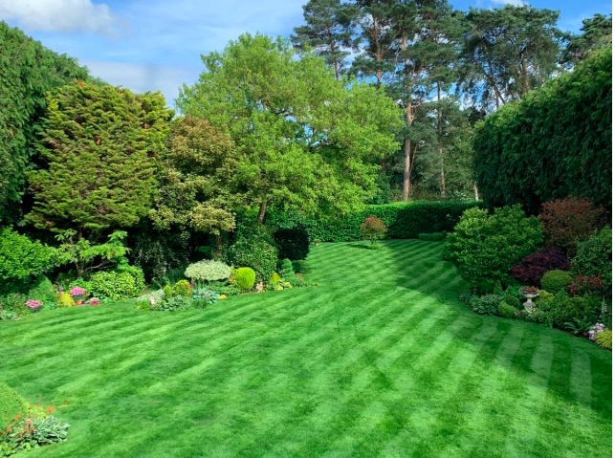
“It’s Not Keeping Lawns it’s keeping Soil”
Field Compost Ltd

