Slide 2
Soil Biology in Lawn turf
Ian Robertson

Slide 3

Look what's over the hill!
The European Commission will propose a Soil Health Law in 2023. Such a legal framework will contribute to the achievement of the Soil Strategy 2030 objectives, grant soils the same level of protection as water and air and radically improve the condition of soils to better provide the ecosystem services that we depend on.
Will this affect lawncare?

Slide 4
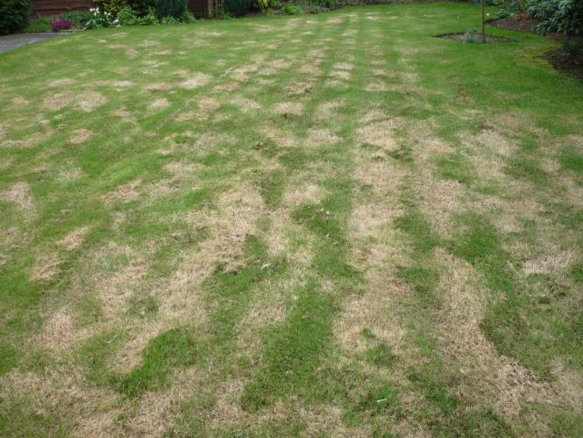
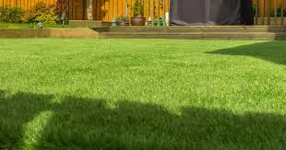
Biggest asset to lawncare is you and your management of the soil
There will be few pictures of lawns as the principles of soil biology are for all soils and plants grown on them

Slide 5
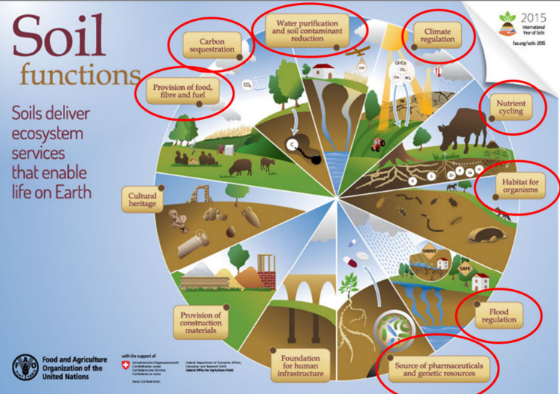

Slide 6
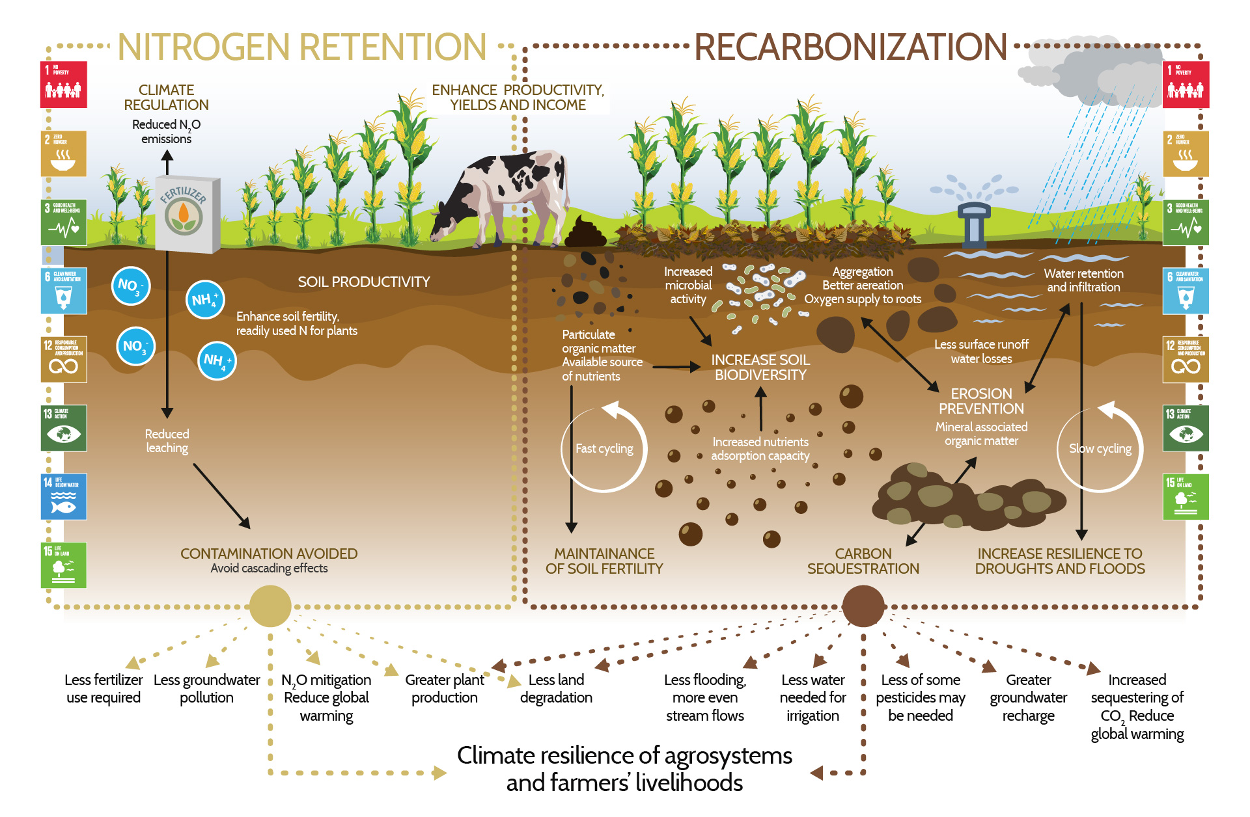

Slide 7
Biology is the driver of soils and therefore grass growth
Functions | Organisms involved
Maintenance of soil structure: functionality | Bioturbating invertebrates and plant roots, mycorrhizae and some other micro-organisms
Regulation of soil hydrological processes: Water | Most bioturbating invertebrates and plant roots
Gas exchange and carbon sequestration (accumulation in soil): Air | Mostly micro-organisms and plant roots, some C protected in large compact biogenic invertebrate aggregates
Soil detoxification | Mostly micro-organisms
Nutrient cycling: food | Mostly micro-organisms and plant roots, some soil- and litter-feeding invertebrates
Decomposition of organic matter: cycle of food and reduction in thatch | Various saprophytic and litter-feeding invertebrates (detritivores), fungi, bacteria, actinomycetes and other micro-organisms
Suppression of pests, parasites and diseases: bio control better than chem | Plants, mycorrhizae and other fungi, nematodes, bacteria and various other micro-organisms, collembola, earthworms, various predators
Sources of food and medicines | Plant roots, various insects (crickets, beetle larvae, ants, termites), earthworms, vertebrates, micro-organisms and their by-products
Symbiotic and asymbiotic relationships with plants and their roots | Rhizobia, mycorrhizae, actinomycetes, diazotrophic bacteria and various other rhizosphere micro-organisms, ants
Plant growth control (positive and negative) | Direct effects: plant roots, rhizobia, mycorrhizae, actinomycetes, pathogens, phytoparasitic nematodes, rhizophagous insects, plant-growth promoting rhizosphere micro-organisms, biocontrol agents Indirect effects: most soil biota
We know this so lets build it

Slide 8
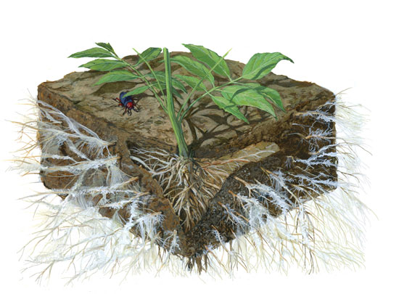
Ultimately soil is a living, breathing entity and must be treated as such

Slide 9
Soil Function – limited by soil type/ health/ structure?
Nutrient cycling: biological N is much more plant water efficient
Carbon store
Structural stability
Speed of water movement through soil profile
All influenced by management

Slide 10
Soil Functionality depends on 3 aspects
Physical
Chemical
Biological
Trophic layers
Food source
Texture
Structure
pH
Nutrients

Slide 11
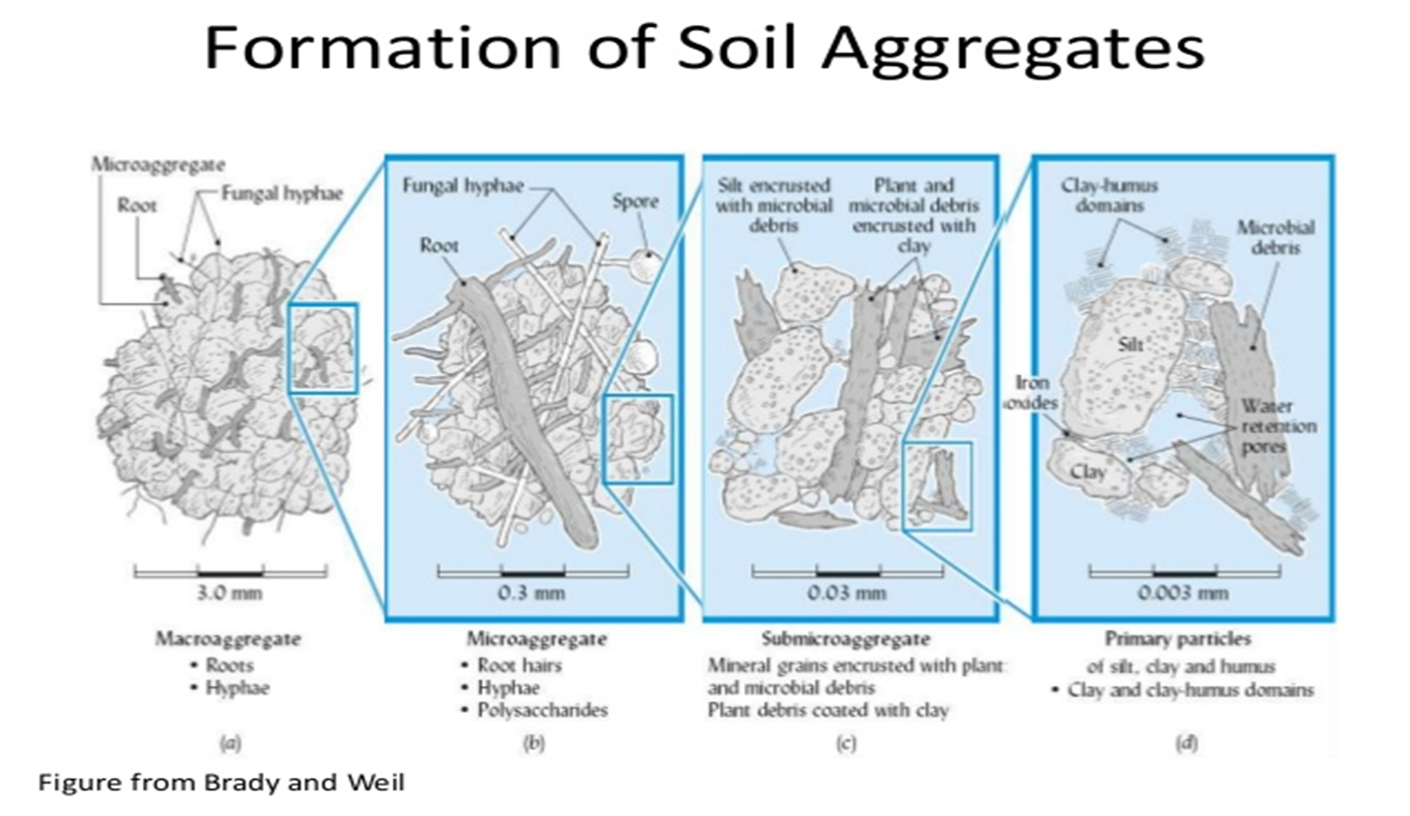
Clay is 1-2 µm
Biology important at all stages to provide the glue to hold the soil together!
Humic particles bind tightly, roots hold more loosely

Slide 12
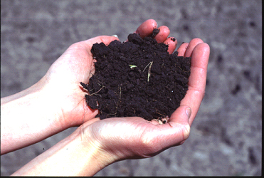
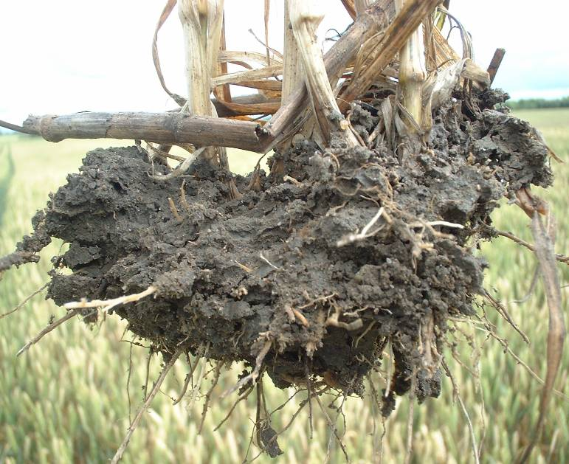
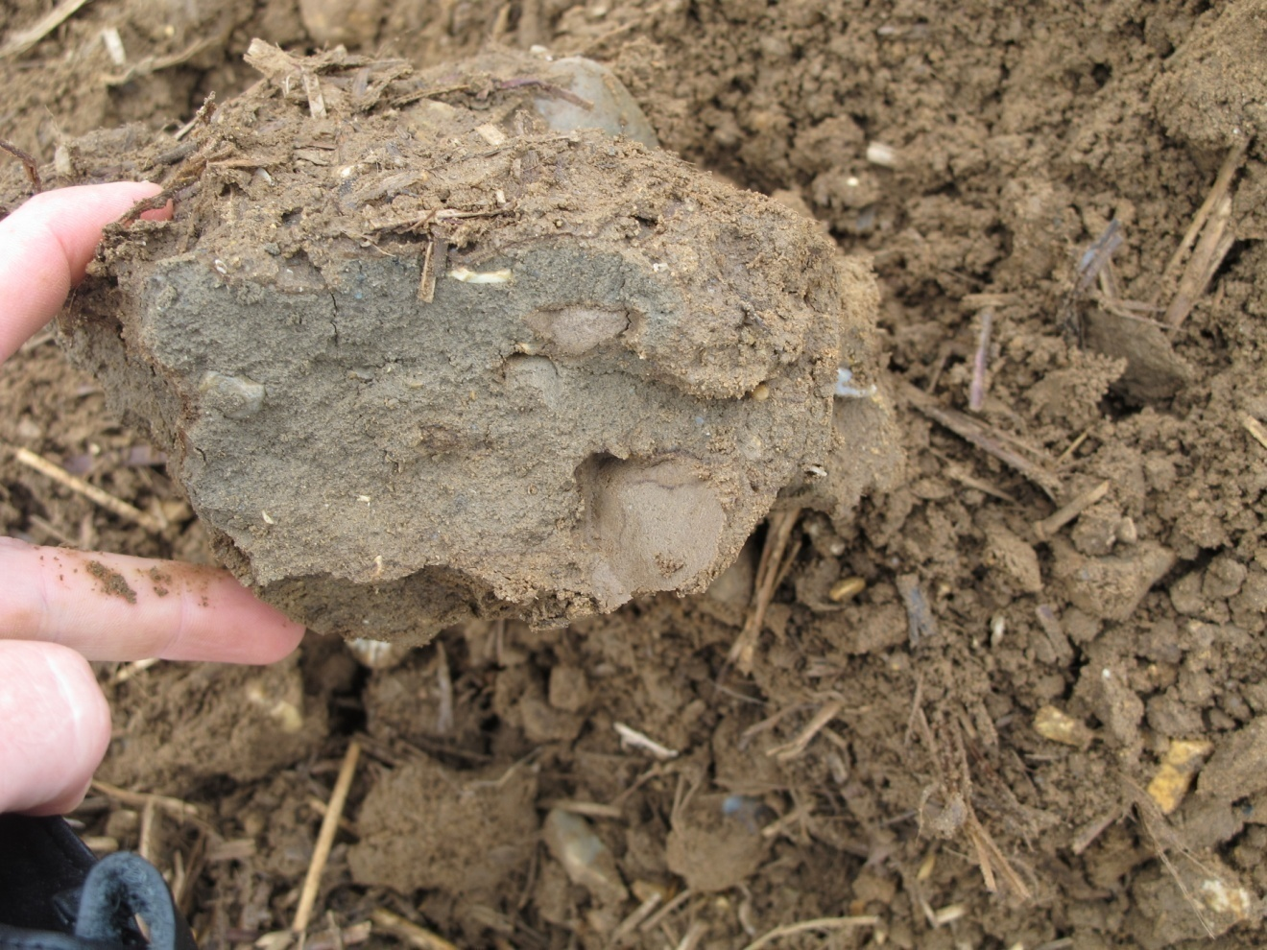
All these soils have the same pH, P, K, Mag levels, will they perform the same?
Looking at things in isolation is dangerous

Slide 13


-ve charge
-ve charge
-ve charge
-ve charge
-ve charge
-ve charge
-ve charge
-ve charge
-ve charge
-ve charge
>
Calcium has a 2+ charge and a large ionic radius –
therefore 'holds' onto soil colloids securely, but at a distance - hence flocculation.
Open Soils
Magnesium also has a 2+ charge but a small ionic radius - therefore 'holds' onto soil colloids securely, but closely - hence coagulation
Tight Soil

Slide 14
How much of soil is soil?
Empty

Slide 15
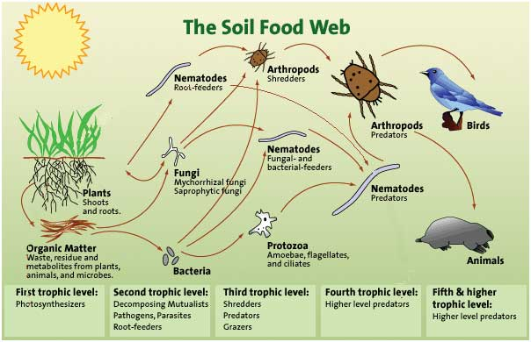
3. Biology
Biology interlink with many soil forming factors:
Acidification
Physical movement
Vegetation cover & degradation

Slide 16
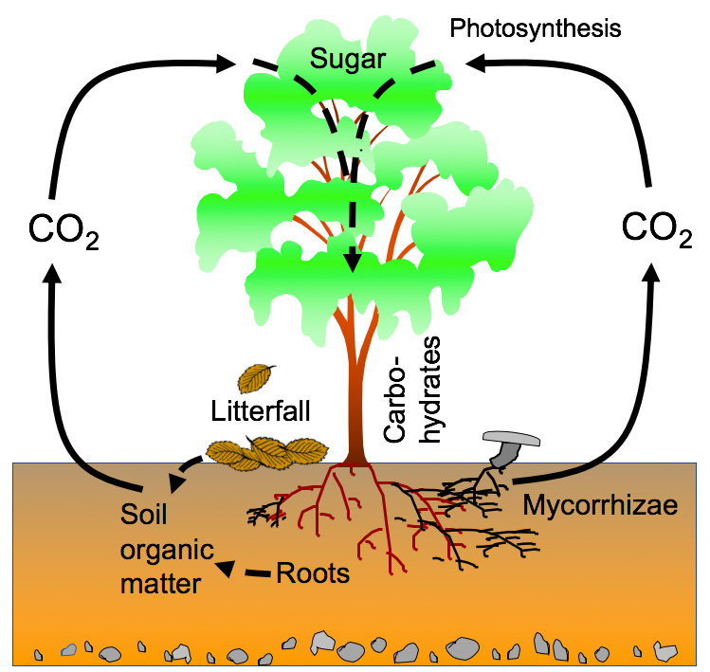
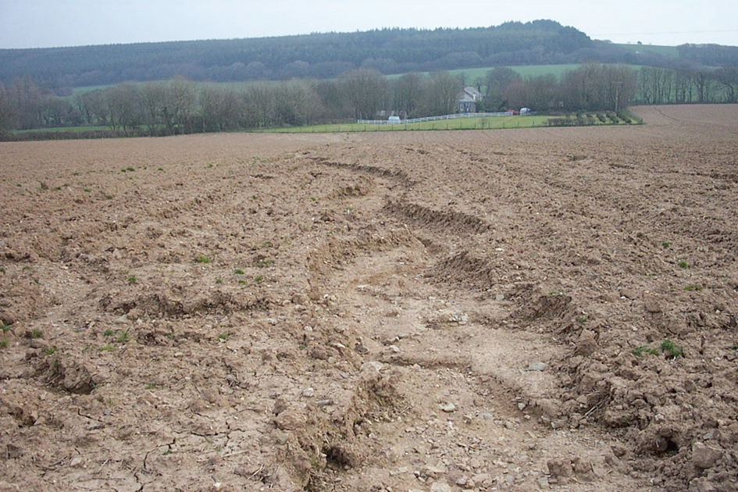
Can’t stop it so you must capture it.
Soil microbes use 24 C/1N they store 8 and release 16 as Co2 . Fuelled by N

Slide 17
Decomposition of organic matter is largely a biological process that occurs naturally. Its speed is determined by three major factors: soil organisms, the physical environment and the quality of the organic matter (Brussaard, 1994).
What areas can we control?

Slide 18
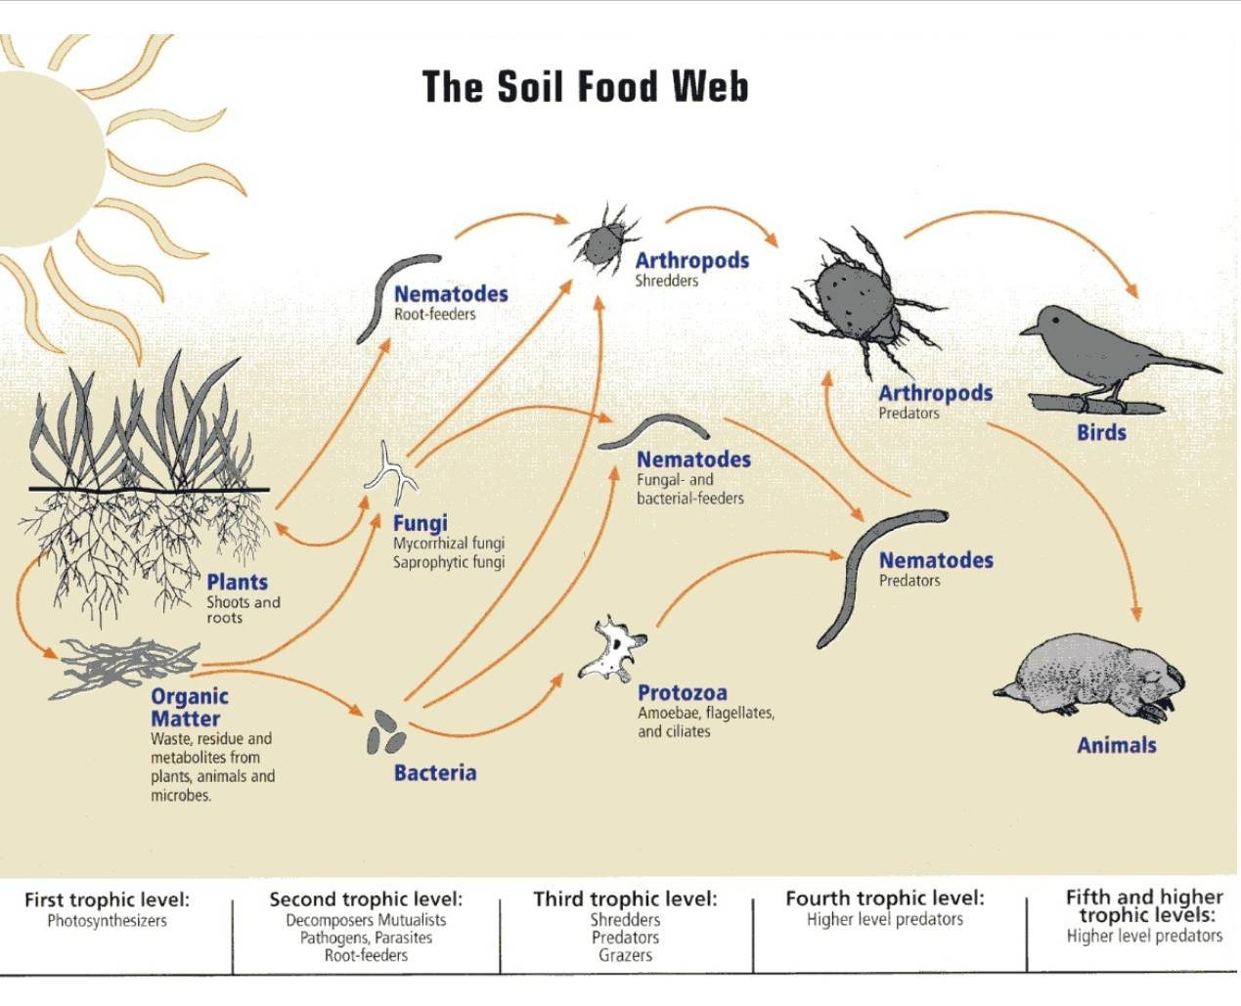
Getting bigger in size
Clay is 1-2 µm
Everything has to excrete = cycling nutrients
1-5µm
100 µm
2-20 mm
Cycle nutrients

Slide 19
Biology is the driver of soils and therefore grass growth
Functions | Organisms involved
Maintenance of soil structure: functionality | Bioturbating invertebrates and plant roots, mycorrhizae and some other micro-organisms
Regulation of soil hydrological processes: Water | Most bioturbating invertebrates and plant roots
Gas exchange and carbon sequestration (accumulation in soil): Air | Mostly micro-organisms and plant roots, some C protected in large compact biogenic invertebrate aggregates
Soil detoxification | Mostly micro-organisms
Nutrient cycling: food | Mostly micro-organisms and plant roots, some soil- and litter-feeding invertebrates
Decomposition of organic matter: cycle of food and reduction in thatch | Various saprophytic and litter-feeding invertebrates (detritivores), fungi, bacteria, actinomycetes and other micro-organisms
Suppression of pests, parasites and diseases: bio control better than chem | Plants, mycorrhizae and other fungi, nematodes, bacteria and various other micro-organisms, collembola, earthworms, various predators
Sources of food and medicines | Plant roots, various insects (crickets, beetle larvae, ants, termites), earthworms, vertebrates, micro-organisms and their by-products
Symbiotic and asymbiotic relationships with plants and their roots | Rhizobia, mycorrhizae, actinomycetes, diazotrophic bacteria and various other rhizosphere micro-organisms, ants
Plant growth control (positive and negative) | Direct effects: plant roots, rhizobia, mycorrhizae, actinomycetes, pathogens, phytoparasitic nematodes, rhizophagous insects, plant-growth promoting rhizosphere micro-organisms, biocontrol agents Indirect effects: most soil biota

Slide 20
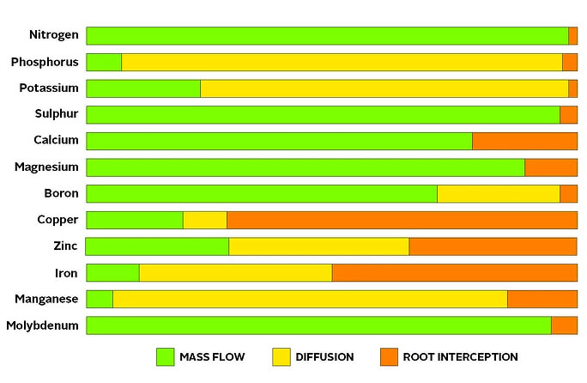
How do nutrients get in to the plant?
Focus on Mass flow= soil functionality
Mass flow
The movement of nutrients in soil solution to the surface of the roots through the flow of water. The flow of the water is a result of wetting and drying or transpiration water uptake by the plants. The rate at which nutrients are taken up by mass flow is determined by the water in the soil and by the amount of water being taken up by the crop.

Slide 21
Functional soils rootzone will give you 100-250Kg N/Ha
100-250 grams/100m2/year

Slide 22

Measure the biology
PLFA: Soil life monitor
SoilBioLab: Simon and microscopes
Microbometer cards

Slide 23
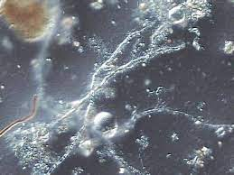
SOIL LIFE MONITOR (PLFA)
This is a lab test measuring the levels of bacteria, fungi and protozoa in the soil
It also measures the diversity of the microbial biomass.
This is a very useful test to see how diverse your soil biology is , the more diverse the better nutrient cycling and the more the soil will give you.
Ideally tests before and after taking management actions.

Slide 25
Summary
Biology is very very important
You can measure it PLFA Diversity test
Manage Physics and chemistry to build the home
Know what you want to grow (dm/m2) cycle or feed to this
Many things make grass green (Fe, Mag, N, K etc)
Make your own or buy from supplier: ensure the house is ready for it.
Every action you do will affect biology

Slide 26
What can I add over and above my normal program?
Microbial Bio stimulants
  Seaweeds
  Organic acids: Fulvic, Humic
  Biological inoculants : BioLevel
  Balancing fert to grass demand:
    Biological Nitrogen
    Amino acids
Test the biology : PLFA: Prowlawncare

Slide 27
Thank you
Ian Robertson
07970286420 ian@soiladvice.com
Get started

