Slide 1
Adapting your Business For The Unknown

Slide 2
Introduction
Jim Hewlett
Green Industry business owner for 36 years
Combined annual turnover IRO £2.6m
1987 - 2023
2006 - 2023
2015 - 2023

Slide 3
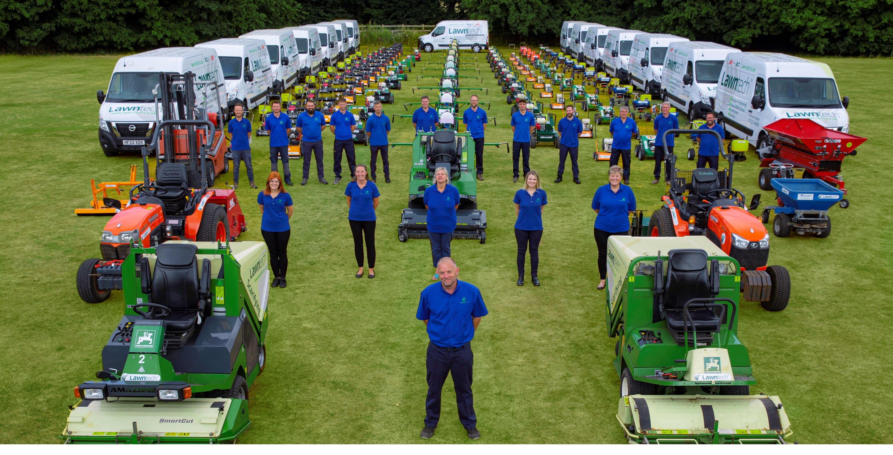
Adapting a Lawn Care business for the unknown

Slide 4
Why do lawn care businesses need to adapt and evolve to thrive?
Weather/Climate/Environmental Change
UK Economy
Drought
Water logging
Frozen conditions
Water Shortages
Product usage
Political Influences
Inflation
Recession
Sustaining Growth
Customer retention

Slide 5
How does an economic downturn affect a Lawn Care business?

Slide 6
Adapting for the unknown………
A history of UK recession
Name | Dates | Duration | Inflation peak
Great Slump | 1430 - 1490 | 60 years | N/A
Great Depression | 1930 - 1931 | 2 years | N/A
Oil Crisis | 1973 - 1975 | 1.25 years | 24.5%
Early 80’s | 1980 - 1981 | 1.25 years | 18%
Early 90’s (black Wednesday) | 1990 - 1991 | 1.25 years | 9.5%
Great Recession (sub-prime mortgage crisis) | 2008 - 2009 | 1.25 years | 5%
Covid Recession | 2020 - 2020 | 0.5 years | 0.85%
Now – 2022/2023 | 2022 -? | ? | 11%

Slide 7
Recession comparisons for UK Lawn care industry
Previous economic recessions VS
Current economic recession
1990/91 There was no lawn care industry in UK, but USA lawn care industry stayed strong and recovered quickly despite very high interest rates and property foreclosures.
2008/2009 Sales & growth for lawn care flatlined but soon recovered in 2009. The most significant and damaging price increase was fuel.
2020 Covid recession, business boomed for most lawn care companies.
Many huge price increases directly affecting the lawn care industry which has not happened in previous recent recessions.
Fuel
Fertiliser
Wages
Machinery
Transportation & delivery
General Inflation/Cost of Living

Slide 8
UKLCA Cost Rise Survey
We surveyed 14 UKLCA companies regarding industry specific price rises in the past 24 months, the question was;
As a percentage, how much have key industry prices risen for you in the past 24 months?
A newly purchased work van, or quote on new van?
A new Aerator ?
A new Scarifier ?
Selective Herbicide?
Fertiliser ?
An Employee (Technician) ?

Slide 9
UKLCA Cost Rise Survey
We surveyed 14 UKLCA companies regarding industry specific price rises in the past 24 months, the question was;
As a percentage, how much have key industry prices risen for you in the past 24 months?
Only 7 replies/50% response
Item | Average Percentage rise
A newly purchased work van, or quote on new van | 38.6% Second Hand 52% New
A new Aerator | 20%
A new Scarifier | 25%
Selective Herbicide | 3.6%
Fertiliser | 64.6%
An Employee (Technician) | 11.92%
Fuel | IRO 40%

Slide 10
Rising Costs = Rising Overheads
Industry Overview
Key products and costs rising to multiple times that of inflation.
Virtually all non-industry specific costs are rising with inflation.
Customer cancellations/churn likely to be higher due to the cost of living.
Cost of acquiring new customers rising due to lower conversions.
Extreme weather potentially causing financial loss.

Slide 11
Jimmy’s Lawn Care (fictitious) – Turnover 300k per year in 2021
Jimmy’s Lawn Care 2021
Turnover 2021 | £300,000
Overheads/Costs = 80% | £240,000
Net profit before tax | £60,000

Slide 12
Jimmy’s Lawn Care (fictitious) – Turnover 300k per year in 2022
Jimmy’s Lawn Care 2022
Turnover 2022 | £300,000
Overheads/Costs = 80% | £240,000
Overheads Rise by 18% | £43,200 = £283,000 – 94.4%
Net profit before tax down to 5.6% | £17,000

Slide 13
Adapting your business to remain profitable
Problem | Solution
Lawn Care Price Increases | Price rises are unavoidable and will be essential to maintain a healthy business. But how much?
Operational Efficiency | Micro analyse your business to find efficiency. Windscreen time/routing Time on each job Amount of product applied per m2 Reduce flexibility with customers
High Company Overheads | Try reducing overheads – could be very difficult and may not be the right thing to do. Seek different products/suppliers? Reduce or increase Marketing costs? Reduce staff/slimline business? Reduce borrowing? Haggle for everything
Business Structure Changes | Do you need to change the core structure of your business model? What worked 5 or 10 years ago might not work now.
Have A Sound Plan | Have a plan for the next 2 years to get through the tough times. Review P&L’s on a monthly basis to look for red flags that need immediate attention.

Slide 14
2023 Outlook
A tough 2023 to come where lawn care business must adapt.
A glimmer of hope already in 2023 with a more stable government and inflation showing signs of reversing.
Fertiliser costs are showing signs of becoming more competitive/reversing in cost.
Fuel has started to come down.
Real signs of recovery in US.
Rolls Royce sold more cars in 2022 than ever before.

Slide 15
Questions Please

