Slide 1
LAWN ASSURED UKLCA Conference 2023 Teresa Meadows Head of Environment, Audit and Public Affairs

Slide 2
AGENDA
BASIS
Amenity Standard
Lawn Assured
Audit scheme
Benefits
How to get involved

Slide 3
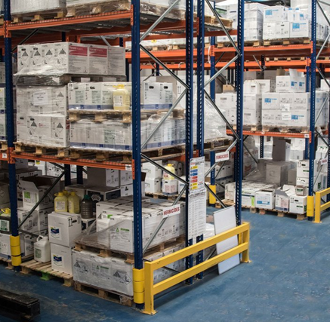
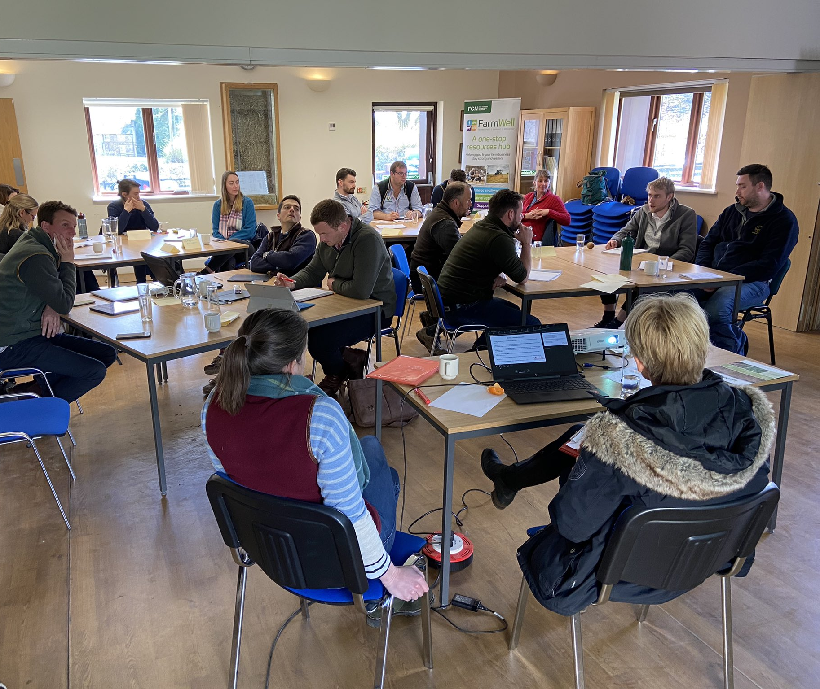
BASIS
BASIS is an independent organisation committed to raising professional standards across land management and food production by supporting people and businesses with our industry leading qualifications, professional registers and auditing schemes.
What does this mean to me?
Notes:
If you work within the crop production industry BASIS delivers three key services:
Accredited qualifications – Some of these are Specified Certificates which means you legally need to hold them to carry out a certain job role – CICP to advise on PPP’s. NSK to act as a storekeeper in a pesticide store.
Range of other accredited qualifications which I will speak about later from Foundation right through to Advanced Certificate
Store Inspection Scheme – Not a legal requirement but stipulated in the Code of Practice for Suppliers of Pesticides stores should be independently assessed with BASIS as the auditor. Why BASIS was first setup in 1978 to ensure pesticides stored correctly to protect the environment. Now provide inspection and auditing schemes for distributor stores, amenity, rodenticides, lawn care etc.
Professional Register – Register of Professionals within the crop production and agronomy industry. To be a member you have to have passed a qualification, keep up to date with CPD and follow our code of ethics. Being a member shows you are suitably qualified and keeping up to date with your knowledge, as well as acting in a professional and responsible way. Widely recognised for agronomists but also other advisers, farm managers etc. Farm Assurance. Can get on to the register as an Associate, Prof Reg Member and/or as a FACTS qualified adviser in a range of industries from comm hort, seed sellers, agriculture, field veg, floriculture etc.

Slide 4
BASIS AUDIT SCHEMES
BASIS Store Inspection Scheme - Professional pesticide stores
Amenity Contractors Scheme - Amenity contractors storage (BACCS)
Contractor only scheme - No fixed store
End user schemes – For example, forestry
Small stores scheme - Under 100l stored
RAMPS only store - Aluminium phosphide storage
Rodenticide Point of Sale Scheme (RPOS)
Amenity Assured
Lawn Assured
‘…independently raising professional standards…’

Slide 5
AMENITY STANDARD
The Amenity Standard aims to demonstrate that all those carrying out amenity management are operating to the highest professional standard and ensuring that all aspects of their work are conducted in a safe and healthy way, to produce public spaces fit for purpose.
Administered by the Amenity Forum
Assurance schemes include:
Amenity Assured (operated by BASIS)
Lawn Assured (operated by BASIS)
Invasive Weed Control (operated by the Property Care Association)
theamenitystandard.co.uk

Slide 6
LAWN ASSURED
Forms part of the Amenity Standard
Annual assessment for lawn care companies
Designed in conjunction with the lawn care industry
Specific standard for the lawn care sector
Supported by inspecting authorities, including HSE/CRD and the environmental regulators

Slide 7
THE CONTEXT - LEGISLATION
Key legislation
Environment Targets
National Action Plan for Pesticides

Slide 8
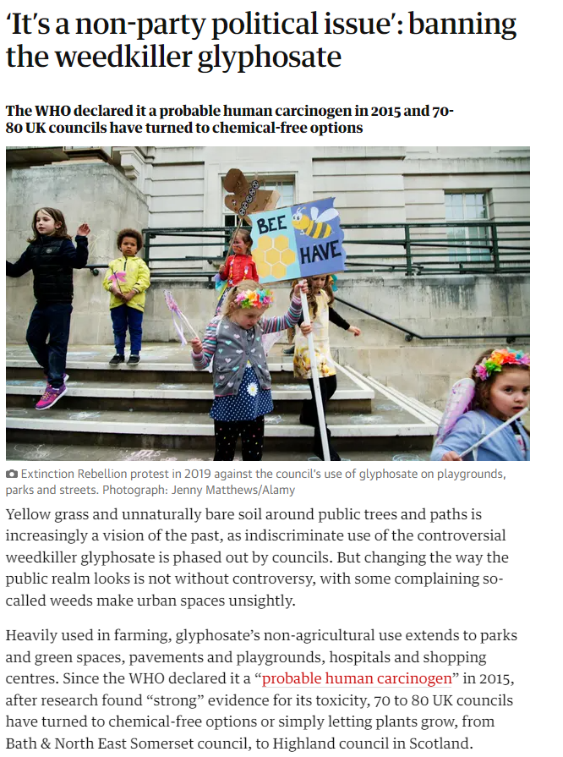
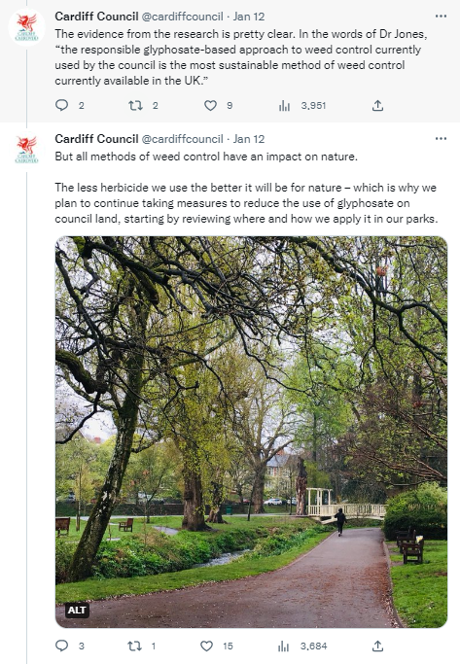
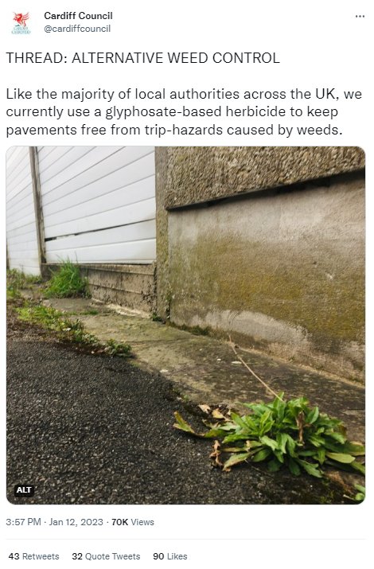
THE CONTEXT - CUSTOMER

Slide 9
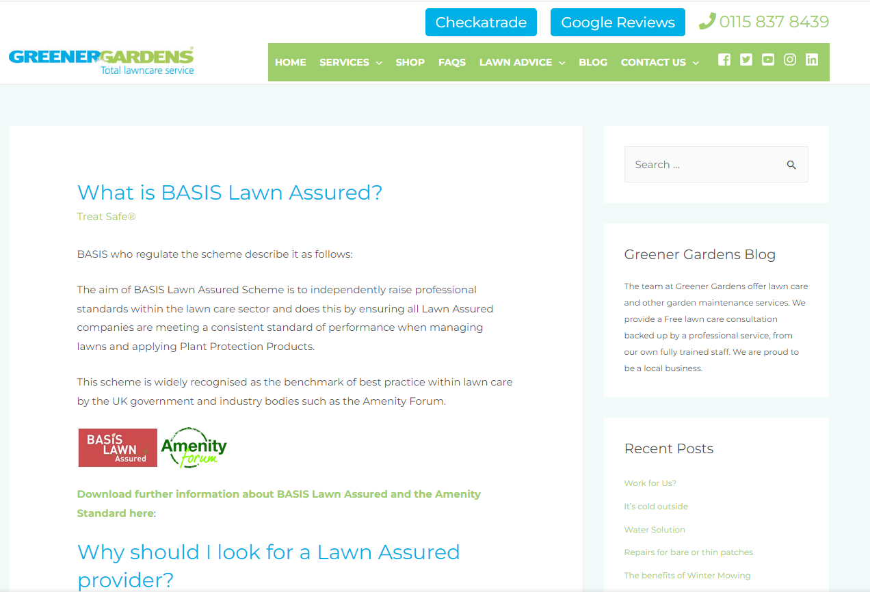
THE CONTEXT – YOUR BUSINESS
Environmental consciousness
Business benefits:
Costs
Tenders
Customer recognition
Compliance
Staff training

Slide 10
THE CONTEXT

Slide 11
LAWN ASSURED – SELF AUDIT
Self-audit form completed
On-site audit
Membership certificate
&
Lawn Assured Compliant Contractors List
Includes supporting evidence.
BASIS report provided with corrective actions, if needed.
All new members and 25% of existing members each year.

Slide 12
LAWN ASSURED – SELF AUDIT
Company/organisation
Personnel, qualifications, competence and training
Application (Equipment and records)
Transport
Pesticide storage
Fertiliser stores
Customer satisfaction

Slide 13
LAWN ASSURED – ON-SITE AUDIT
Notes:
On-site visits by independent BASIS auditors to verify operational procedures

Slide 14
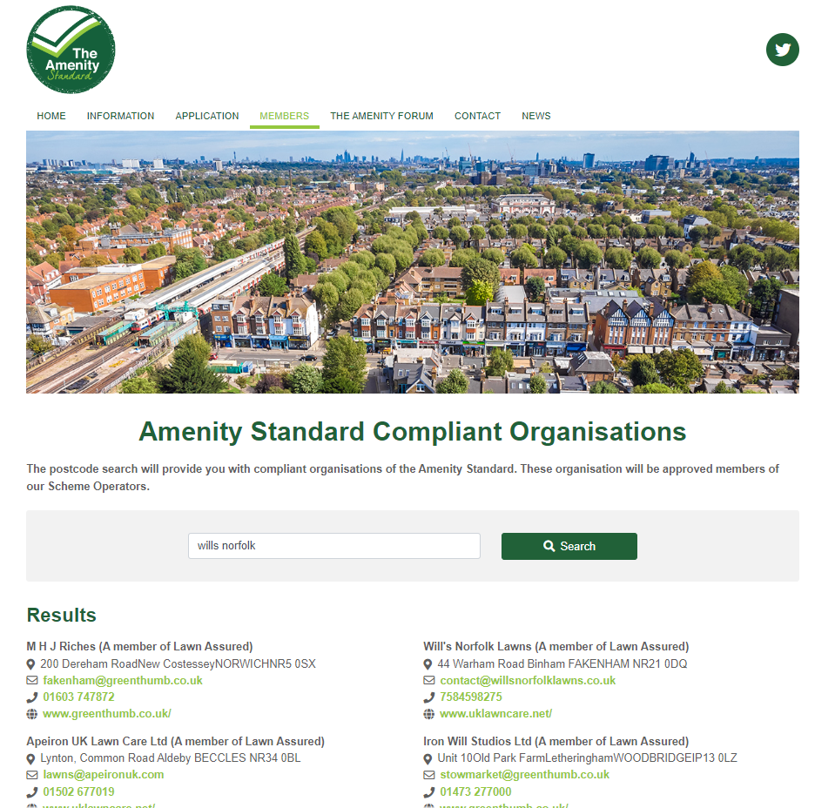
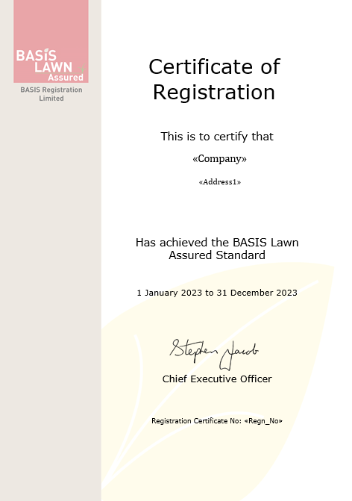
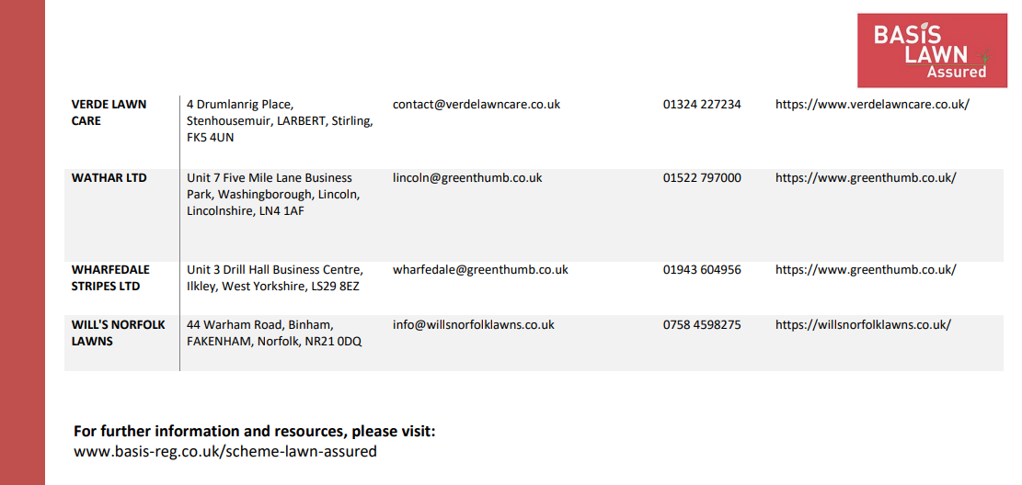
LAWN ASSURED – MEMBER

Slide 15
LAWN ASSURED NEW!
Updated continuous professional development (CPD) section
Monthly Lawn Assured Compliant Contractors updates
Public facing information on BASIS website and social media
Self-audit completed online and digital portal
Integrated pest/weed management training

Slide 16
MEMBER BENEFITS – PUBLIC
Independent auditing scheme for companies to publicly demonstrate a commitment to environmental safety and the sustainable use of plant protection products.
A voluntary industry-led scheme ensuring compliance with regulations and best practice that is recognised by UK government and industry bodies.
Ensures all companies meet a consistent standard of performance across the audit areas.
A quality standard for members to be proud of that shows their commitment to following best practice and managing lawn care in a safe and sustainable way.

Slide 17
MEMBER BENEFITS - BUSINESS
Full BASIS and UKLCA support
Use of BASIS Lawn Assured and Amenity Standard logos on website, e-mails, vehicles and promotional materials
Auditor guidance
Reduced cost for UKLCA members
BASIS Bulletin
Public affairs support

Slide 18
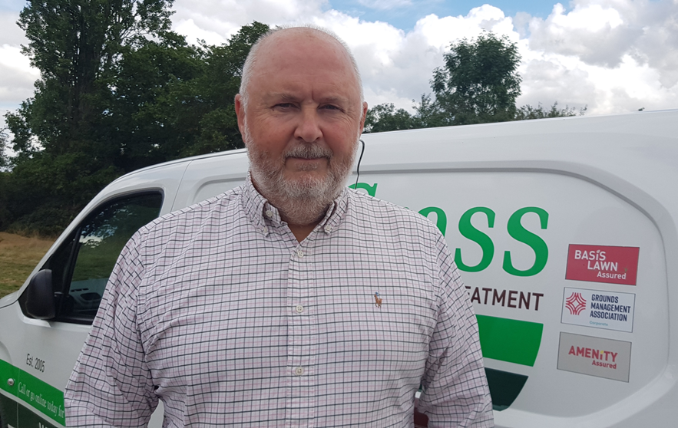
JOIN TODAY
For more information: basis-reg.co.uk/scheme-lawn-assured
To join, contact :
Kate Hopkins - secretary@uklawncare.net
BASIS team (Kim and Lindsay) - auditing@basis-reg.co.uk / 01335 301207

Slide 19
Thank you! Any questions? Teresa Meadows teresa.meadows@basis-reg.co.uk auditing@basis-reg.co.uk 07943 820505 / @EnviroTeresa
…committed to being net zero and nature positive…

